Slide 1




Monday (P1), 9A Lasallian Education
WHITEBOARD
 |  | John | Marcus
 | Donnacha | William | Ben
 | Jeffery | Da Feng | Ryan
Ariel | Nano | Ziyi | Grace
Yui | Heidi | Talia | Xiao Hui
Brandon | DJ | Jin Heng
= HiPo
= EAL
= Beh
TEACHER’S TABLE
= SEN
EALT1 | EALT2 | EALT3 | EALT4

Slide 2
Monday (P2), 9E Lasallian Education
WHITEBOARD
 |  |  | Kai Jie
Furina | Maya | Amy | Chloe
Jack |  | Jingyi | Lily
Celine | Letitia | Lydia | Keira
Ray | Damon | Jonas | Brian
Jing Le | James | Yu-Joh | Aditya
= HiPo
= EAL
= Beh
TEACHER’S TABLE
= SEN
EALT1 | EALT2 | EALT3 | EALT4

Slide 3


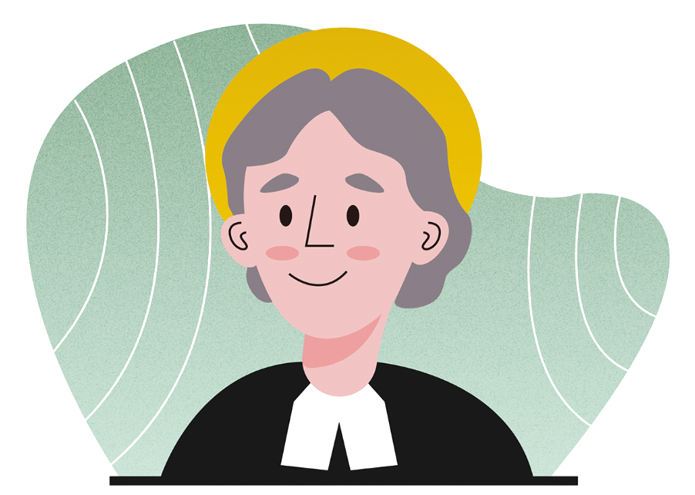

LASALLIAN EDUCATION
FAITH ★ SERVICE ★ COMMUNITY
Good morning
Welcome to another
Awesome LEDU class
Unit 1 | Term 1 | Lesson 2
Br. Carlo FSC

Slide 4
LASALLIAN EDUCATION
FAITH ★ SERVICE ★ COMMUNITY
The Heart of Service: Nurturing Faith in Our Lasallian Family
Unit 1 | Term 1 | Lesson 2
Br. Carlo FSC

Slide 5

LASALLIAN EDUCATION
FAITH ★ SERVICE ★ COMMUNITY
Lesson
Flow
Introduction to Lesson
Lesson Proper
Activities & Reflections
Key Takeaways
Q&A
Reflection Log Time

Slide 6
LASALLIAN EDUCATION
FAITH ★ SERVICE ★ COMMUNITY
Enquiry Question
How does our faith motivate us to be better team players and build a community of service?

Slide 7
LASALLIAN EDUCAITON
FAITH ★ SERVICE ★ COMMUNITY
Lesson Objectives
Explain the connection between faith and service within the Lasallian tradition.
Identify personal beliefs and values that can help them be effective team players.
Practice simple reflection to understand their own role in the community.
Begin brainstorming ideas for the Capstone Project.

Slide 8
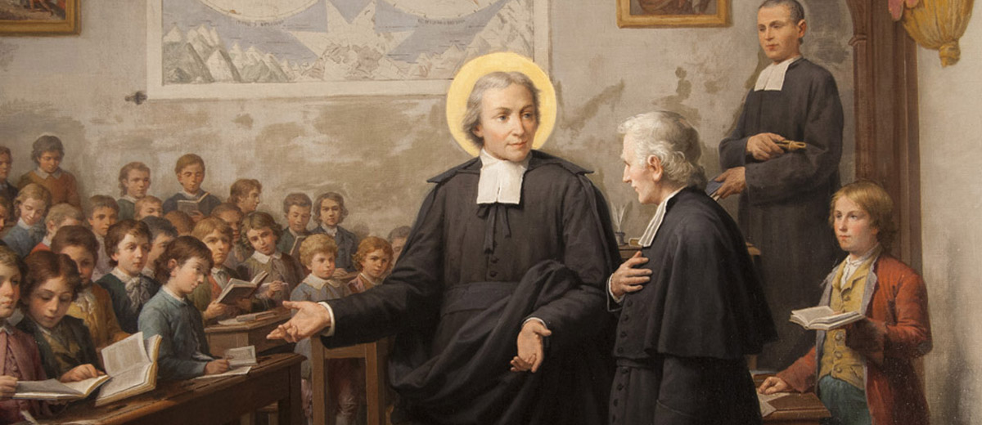


LASALLIAN EDUCATION
FAITH ★ SERVICE ★ COMMUNITY
Character Education Focus: A LASALLIAN IS A TEAMPLAYER
This lesson will emphasize how the qualities of a good team player—trust, communication, shared goals, and supporting others—are all rooted in a Lasallian faith. We will explore how personal reflection and a shared sense of mission (faith) unite individuals into a cohesive and effective team (community of service).

Slide 9


LASALLIAN EDUCATION
FAITH ★ SERVICE ★ COMMUNITY
Our school community is also a team, and that our "game" is the mission of service.

Slide 10
LASALLIAN EDUCATION
FAITH ★ SERVICE ★ COMMUNITY
Faith is what gives us the shared purpose and trust needed to be effective team players.
When we have faith in our mission and in each other, we can work together to serve our community.

Slide 11
LASALLIAN EDUCATION
FAITH ★ SERVICE ★ COMMUNITY
YEAR 9 CAPSTONE:
LEDU TALKS | MY STORY OF FAITH
This capstone project is designed to be the culminating assessment for the Year 9 Term 1 unit, "Foundations of Faith and Teamwork: Building a Lasallian Community of Service."
It requires students to synthesize their learning and articulate their personal understanding of faith within the context of their Lasallian identity.

Slide 12
LASALLIAN EDUCATION
FAITH ★ SERVICE ★ COMMUNITY
Step 1: Personal Understanding of Faith
Step 2: Connection to Lasallian Values
Step 3: Shaping Experiences
Step 4: Insights on Actions and Relationships
Step 5: Concrete Future Actions

Slide 13
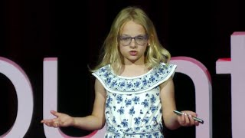
The Power of Prayer | Breelynd Phelps
https://www.youtube.com/watch?v=pdPacGFJnDA
Notes:
Example of how we imagine the LEDU TALKS

Slide 14
NAME OF SUBJECT
FAITH ★ SERVICE ★ COMMUNITY
Step 1: Personal Understanding of Faith
Breelynd defines faith as an active, daily conversation with God through prayer. She explains that prayer is not just a formal ritual, but a safe space where she can speak her fears and worries out loud. For her, faith means trusting that God hears her voice and provides an immediate sense of inner peace and comfort when she is feeling overwhelmed.
Step 2: Connection to Lasallian Values
Breelynd connects her faith directly to core community values by shifting her focus outward. While she uses prayer for personal comfort, she emphasizes that she constantly prays for her family, teachers, sick people, and friends. By holding space for others, she embodies the Lasallian value of being a "team player" who builds up and protects the community through spiritual solidarity.
Step 3: Shaping Experiences
Breelynd shares two profound personal experiences that have deeply shaped her spiritual journey:
Being an Answered Prayer: She reveals that her parents faced unexplained infertility for years before she was born. Knowing she is an "answered prayer" gives her life a deep sense of purpose.
Handling Unanswered Prayers: She reflects on times God said "no" or "not yet" to her requests, explaining that those moments taught her patience and showed her that God often has a better plan in store.
Step 4: Insights on Actions and Relationships
Breelynd explains that her faith directly changes how she treats the people around her. By declaring herself a "mighty leader," she uses her faith to build healthier relationships. She notes that praying for others—even those who are difficult to get along with—removes personal judgment, softens interpersonal friction, and allows her to approach her peers with genuine empathy and kindness.
Step 5: Concrete Future Actions
Breelynd concludes her talk with an explicit, actionable roadmap for her listeners. She challenges her audience to stop keeping their worries bottled up and instead start verbalizing them out loud. Her concrete call to action is for everyone to actively use the power of prayer in their daily lives to manage stress, support their peers, and foster a more connected, caring environment.

Slide 15
NAME OF SUBJECT
FAITH ★ SERVICE ★ COMMUNITY
Step 1: Personal Understanding of Faith
Breelynd defines faith as an active, daily conversation with God through prayer. She explains that prayer is not just a formal ritual, but a safe space where she can speak her fears and worries out loud. For her, faith means trusting that God hears her voice and provides an immediate sense of inner peace and comfort when she is feeling overwhelmed.

Slide 16
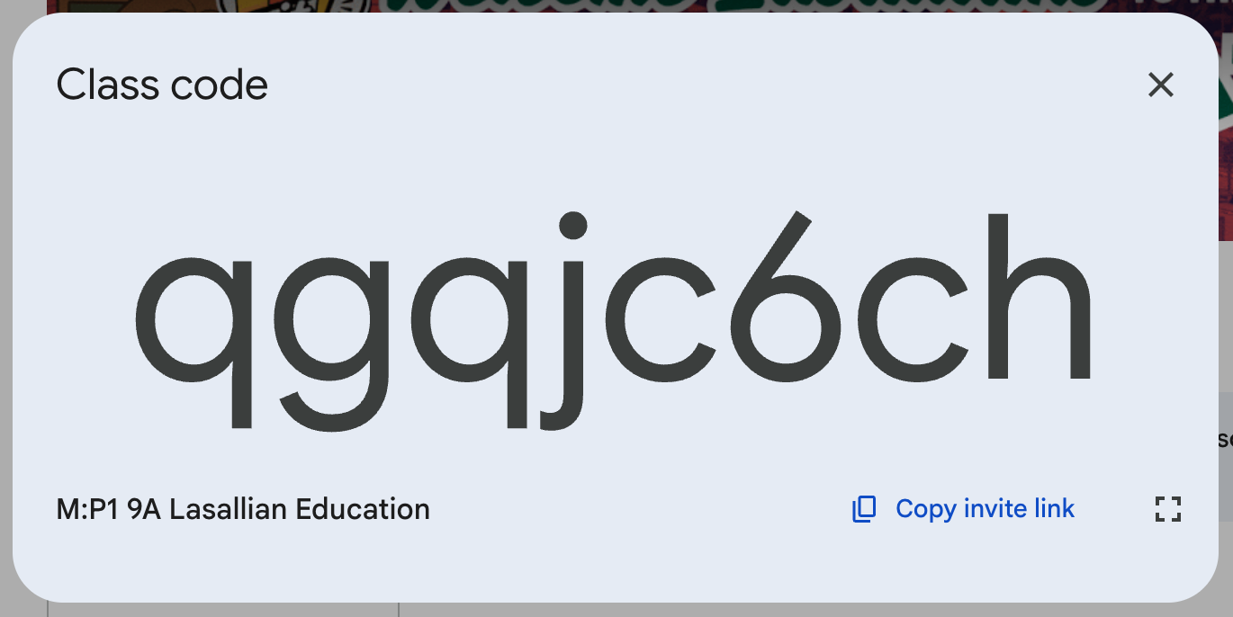

Slide 17
NAME OF SUBJECT
FAITH ★ SERVICE ★ COMMUNITY
Step 1: Personal Understanding of Faith
What does "faith" look like in your daily routine?

Slide 18
NAME OF SUBJECT
FAITH ★ SERVICE ★ COMMUNITY
Step 1: Personal Understanding of Faith
How does your faith help you handle difficult emotions like worry, fear, or stress?

Slide 19
NAME OF SUBJECT
FAITH ★ SERVICE ★ COMMUNITY
Step 1: Personal Understanding of Faith
If you had to explain your faith to someone using a metaphor, what would it be?

Slide 20
NAME OF SUBJECT
FAITH ★ SERVICE ★ COMMUNITY
Step 1: Personal Understanding of Faith
Step 2: Connection to Lasallian Values
Step 3: Shaping Experiences
Step 4: Insights on Actions and Relationships
Step 5: Concrete Future Actions

Slide 21
NAME OF SUBJECT
FAITH ★ SERVICE ★ COMMUNITY
Step 1: Personal Understanding of Faith
Breelynd defines faith as an active, daily conversation with God through prayer. She explains that prayer is not just a formal ritual, but a safe space where she can speak her fears and worries out loud. For her, faith means trusting that God hears her voice and provides an immediate sense of inner peace and comfort when she is feeling overwhelmed.
Step 2: Connection to Lasallian Values
Breelynd connects her faith directly to core community values by shifting her focus outward. While she uses prayer for personal comfort, she emphasizes that she constantly prays for her family, teachers, sick people, and friends. By holding space for others, she embodies the Lasallian value of being a "team player" who builds up and protects the community through spiritual solidarity.
Step 3: Shaping Experiences
Breelynd shares two profound personal experiences that have deeply shaped her spiritual journey:
Being an Answered Prayer: She reveals that her parents faced unexplained infertility for years before she was born. Knowing she is an "answered prayer" gives her life a deep sense of purpose.
Handling Unanswered Prayers: She reflects on times God said "no" or "not yet" to her requests, explaining that those moments taught her patience and showed her that God often has a better plan in store.
Step 4: Insights on Actions and Relationships
Breelynd explains that her faith directly changes how she treats the people around her. By declaring herself a "mighty leader," she uses her faith to build healthier relationships. She notes that praying for others—even those who are difficult to get along with—removes personal judgment, softens interpersonal friction, and allows her to approach her peers with genuine empathy and kindness.
Step 5: Concrete Future Actions
Breelynd concludes her talk with an explicit, actionable roadmap for her listeners. She challenges her audience to stop keeping their worries bottled up and instead start verbalizing them out loud. Her concrete call to action is for everyone to actively use the power of prayer in their daily lives to manage stress, support their peers, and foster a more connected, caring environment.

Slide 22

Thank you!
Any questions or clarifications?

